Slide 1


PROJECT TITLE
EFFICIENT CPU SCHEDULING SIMULATOR
Project mentor:- Dr. Dinesh Dobhal
Team Name:- Code Wizards
Team Code:- OS_SE_IV_12
Presented By:- Arya Ranjan
Khushbu Rauthan
Mahak Rauthan
Shivani

Slide 2

PROJECT OVERVIEW
The CPU Scheduling Simulator is a tool that simulates the execution of multiple CPU scheduling algorithms to help users understand process management and system performance. It allows users to input process details such as name, burst time, arrival time, and priority, and then select one of the following algorithms for simulation:
First-Come-First-Serve (FCFS)
Round Robin (RR)
Shortest Job Next (SJN)
Shortest Job First (SJF)
Priority Scheduling
The simulator calculates key metrics like waiting time, turnaround time, and completion time for each process. It helps users visualize the impact of different scheduling strategies on process execution.

Slide 3
OBJECTIVE
The main objectives of this project are:
To implement and demonstrate different CPU scheduling algorithms.
To provide an interactive GUI for easy input and visualization of process execution.
To calculate and display key performance metrics like waiting time, turnaround time, and completion time for each process.
To provide users with the ability to test and compare the performance of various scheduling algorithms.

Slide 4
TECHNOLOGY STACK
Python: Backend logic for implementing scheduling algorithms.
Tkinter: GUI for user interaction, allowing users to input data and view results.
Algorithms Implemented:
FCFS (First-Come-First-Serve): Processes are executed in the order of their arrival.
Round Robin: Processes are executed cyclically with a fixed time quantum.
SJN (Shortest Job Next): Executes the process with the shortest burst time first.
SJF (Shortest Job First): Non-preemptive scheduling where the shortest job is selected for execution.
Priority Scheduling: Processes are executed based on their priority, with higher priority processes executed first.

Slide 5
Technical Progress
Features Completed:
GUI interface to input process details (Name, Burst time, Arrival time, Priority).
Dropdown to select scheduling algorithm (FCFS, SJN, SJF, Round Robin, Priority).
Input field for quantum time (used in Round Robin).
Buttons to add process and run scheduling.
Output area to show the results in tabular format.

Slide 6
WORK FLOW
User Input:
The user enters the process name, burst time, arrival time, and priority (if applicable).
Users can add multiple processes.
2. Process Scheduling:
The user selects one of the five scheduling algorithms.
The selected algorithm is applied to the processes entered by the user.
3. Execution and Output:
The simulator calculates waiting time, turnaround time, and completion time for each process.
Results are displayed in a table format showing process details and performance metrics.

Slide 7
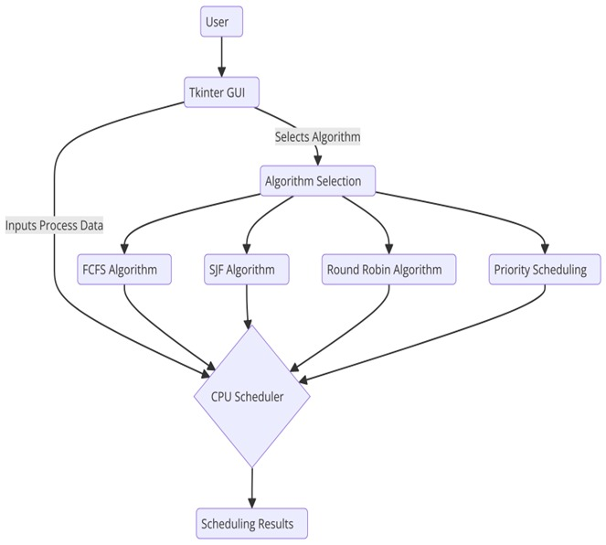
SYSTEM ARCHITECTURE

Slide 8
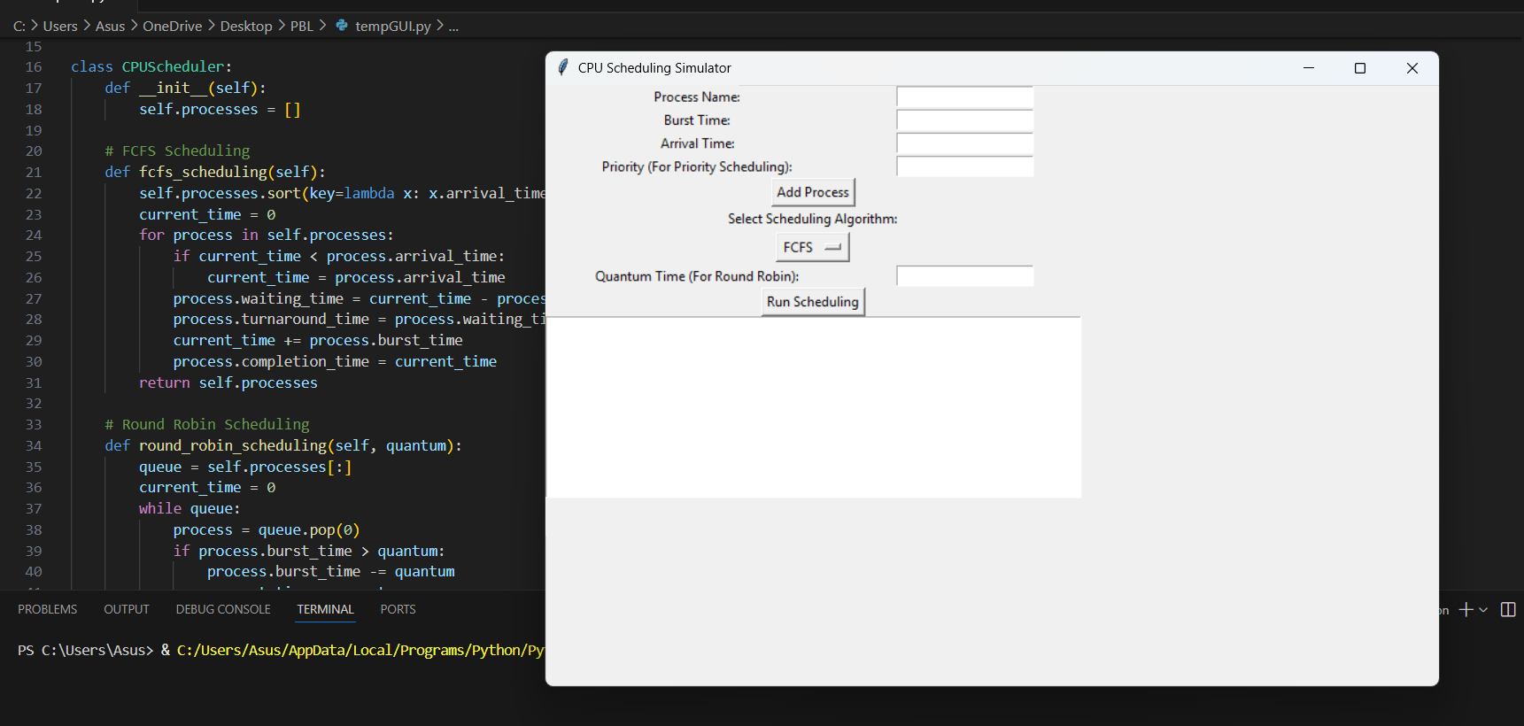
GUI Screenshot

Slide 9
CONCLUSION
The CPU Scheduling Simulator effectively demonstrates how different scheduling algorithms impact process execution and system performance. By implementing algorithms like FCFS, Round Robin, SJN, SJF, and Priority Scheduling, the project provides a clear understanding of how CPU time is allocated based on various strategies. It helps users visualize key metrics such as waiting time, turnaround time, and completion time, thereby enhancing their understanding of CPU scheduling concepts.

Slide 10
ROLES AND RESPONSIBILITIES OF MEMBERS
Arya Ranjan (Team Leader): GUI design and backend logic, integration, and testing.
Khushbu Rauthan: User interaction and UI enhancements.
Mahak Rauthan: Process management and algorithm selection.
Shivani: Algorithm support and result display.

Slide 11


